Slide 1

Natural Language Processing of Clinical Data
Giheon Koh, University of Central Arkansas
Conway, Arkansas
Ahmad Baghal, MD, MS

Slide 2
INTRODUCTION
Electronic Medical Reports (EMRs)
digital equivalent of paper records, or charts at a clinician’s office.
typically contain general information such as treatment and medical history about a patient as it is collected by the individual medical practice.

Slide 3
INTRODUCTION
Concerns
With the rapid adoption of EMRs, it is desirable to harvest(extract) valid and accurate information and knowledge from EMRs to support automated systems at the point of care and to enable secondary use of EMRs for clinical and transitional research.
Natural Language Processing Tool has been developed to facilitate information extraction from the clinical free text.
Kavishwar B Wagholikar, Kathy L MacLaughlin, Michael R Henry, Robert A Greenes, Ronald A Hankey, Hongfang Liu, Rajeev Chaudhry, Clinical decision support with automated text processing for cervical cancer screening, Journal of the American Medical Informatics Association, Volume 19, Issue 5, September 2012, Pages 833–839, https://doi.org/10.1136/amiajnl-2012-000820
Wang, Y., Wang, L., Rastegar-Mojarad, M., Moon, S., Shen, F., Afzal, N., … Liu, H. (2018). Clinical information extraction applications: A literature review. Journal of biomedical informatics, 77, 34–49. doi:10.1016/j.jbi.2017.11.011
Notes:
According to Laurie Miles [1], she mentioned, “About 75% of data is unstructured, coming from sources such as text, voice and video.”
Especially in clinical field, it is very important to extract as much information as possible to improve the quality of clinical procedures.

Slide 4
INTRODUCTION
What is Natural Processing Language?
“A subfield of computer science that tries to learn, understand, and produce human language contents.”
Assale, M., Dui, L. G., Cina, A., Seveso, A., & Cabitza, F. (17 april 2019). The Revival of the Notes Field: Leveraging the Unstructured Content in Electronic Health Records. Frontiers in Medicine,1-23. doi:10.3389

Slide 5
INTRODUCTION
Advantages and Challenge
Advantages
- Reduction of time for manual expert review
- Flexibility of secondary use of such data for large scale automated processing
- More knowledge about patient information
- Conductibility of secondary use of data for future research
Challenges
- poor structures, abundant shorthand, and domain-specific vocabularies → cause HIGH TEST ERROR RATE
Kreimeyer, K., Foster, M., Pandey, A., Arya, N., Halford, G., Jones, S. F., . . . Botsis, T. (17 july 2017). Natural Language Processing Systems for Capturing and Standardizing Unstructured Clinical Information. Journal of Biomedical Informatics,1-16. doi:10.1016

Slide 6
Core Terminologies
Corpus
Corpus is a large collection of texts.
It is a body of written or spoken material upon which a linguistic analysis is based.
A corpus provides grammarians, lexicographers, and other interested parties with better descriptions of a language.
Notes:
Corpus is a large collection of texts.

Slide 7
Core Terminologies
Tokenization
“London is the capital and most populous city of England and the United Kingdom.”
[“London”, “is”, “ the”, “capital”, “and”, “most”, “populous”, “city”, “of”, “England”, “and”, “the”, “United”, “Kingdom”, “.”]
Notes:
Idea : To process word recognition, splitting longer strings of text into smaller pieces, or tokens is needed

Slide 8
Core Terminologies
Normalization
Mainly refers to:
Converting all text to the same case (upper or lower)
Removing punctuation
Expanding contractions
Converting numbers to their word equivalents
Notes:
Before further processing, text needs to be normalized. Normalization generally refers to a series of related tasks meant to put all text on a level playing field:
converting all text to the same case (upper or lower),
removing punctuation,
expanding contractions,
converting numbers to their word equivalents, and so on.
Normalization puts all words on equal footing, and allows processing to proceed uniformly

Slide 9
Core Terminologies
stemming
Stemming is the process of eliminating affixes (suffixed, prefixes, infixes, circumfixes) from a word in order to obtain a word stem.
running → run
processing → process automating → automat
operative → operat
…
Notes:
Stemming is the process of eliminating affixes (suffixed, prefixes, infixes, circumfixes) from a word in order to obtain a word stem.

Slide 10
Core Terminologies
Lemmatization
Lemmatization is related to stemming, differing in that lemmatization is able to capture canonical forms based on a word's lemma.
better → good
worse → bad
diagnosis → diagnos
diagnoses → diagnosi
am/are/is → be
…

Slide 11
Core Terminologies
Stop words
filtered out before further processing of text
contribute little to overall meaning
generally the most common words in a language.
In the century, data is the most important keyword
describing the world that we are living in.
…
Notes:
Stop words are those words which are filtered out before further processing of text, since these words contribute little to overall meaning, given that they are generally the most common words in a language. For instance, "the," "and," and "a,” …..

Slide 12
Core Terminologies
Part-Of-Speech (POS) tagging
Proper Noun (NP)
Noun (NN)- Daniel, London, …
Verb (VBD)- go, speak, run, are, is, …
Adjective(JJ)- big, happy, green, …
Adverb(AD)- slowly, quietly, very, tomorrow, …
Preposition (IN)- at, on, in, from, …
Conjunction (CON)- and, or, but, because, …
Pronoun(PRO)- I, you, we, they, he, she, …
Interjection (INT)- Ouch! Wow! …
Determinant(DT)
Notes:
POS tagging consists of assigning a category tag to the tokenized parts of a sentence.
The most popular POS tagging would be identifying words as nouns, verbs, adjectives, etc.

Slide 13
Procedure
Technologies applied
Python: - NLP requires Machine-Learning algorithms
- Python offers both NLP and ML packages
NLTK (Natural Language Tool Kit) :
- One of the widely used Python package

Slide 14
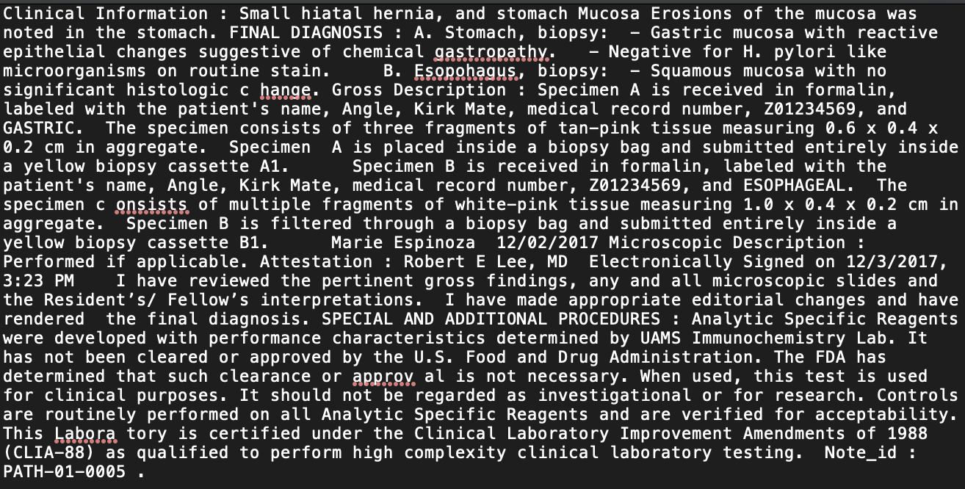
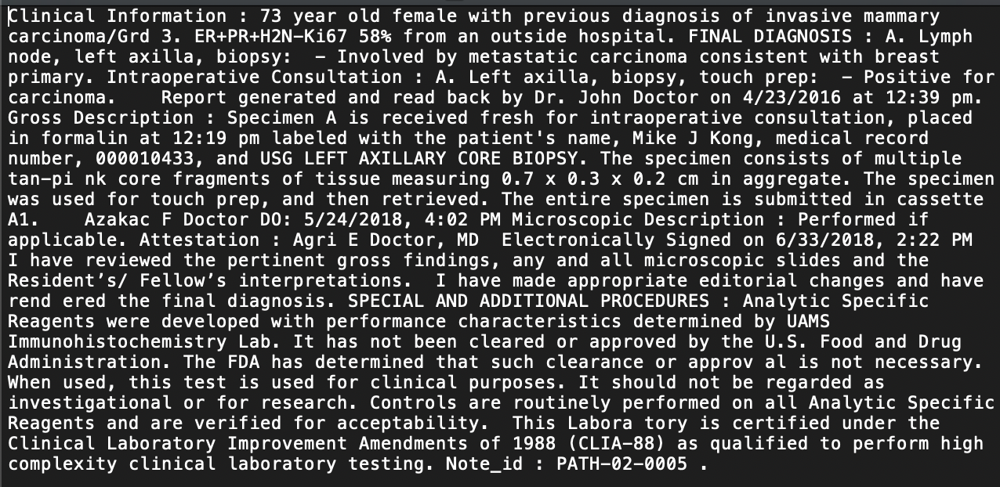
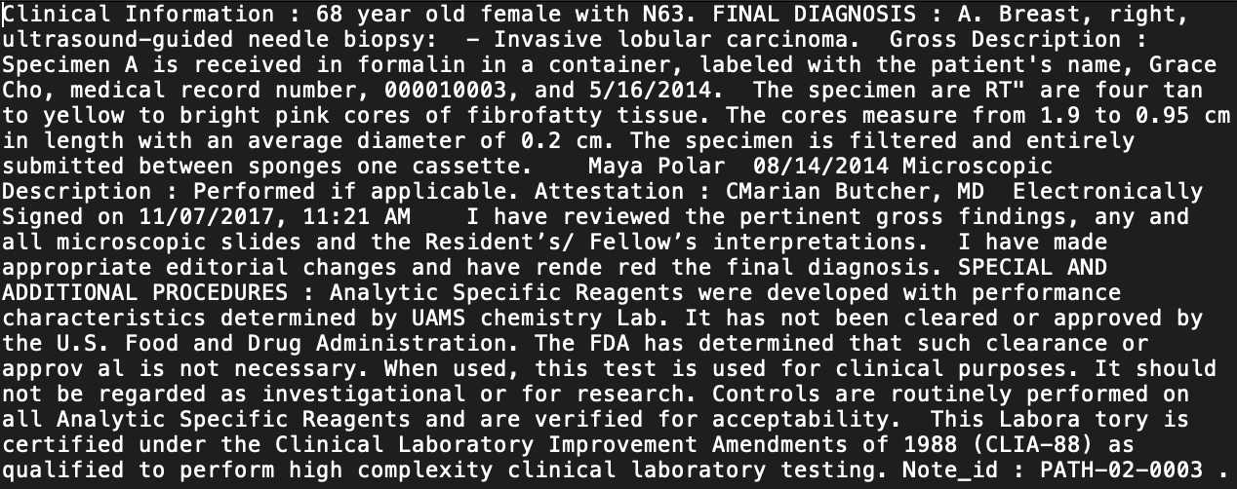
Procedure
Test Samples
20 Deidentified Pathology report samples
Notes:
Total 20 deidentified pathology report samples

Slide 15
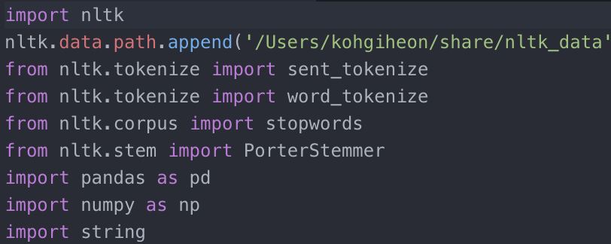
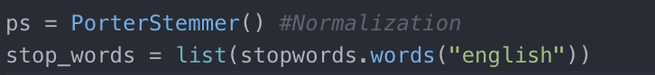
Procedures
Workflow
1. Import necessary Python packages
2. Setting Stemming/Normalization standards and a list of stop words

Slide 16
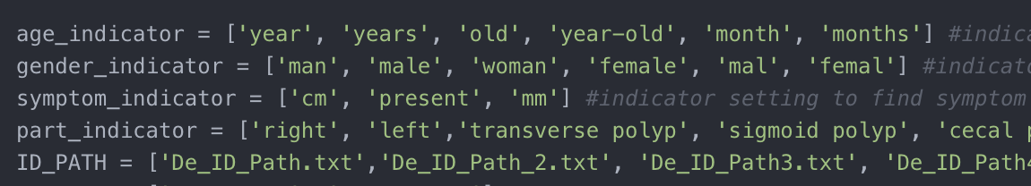
Procedures
Workflow
3. Setting indicators to find location of information
4. locate report files and import into Python

Slide 17
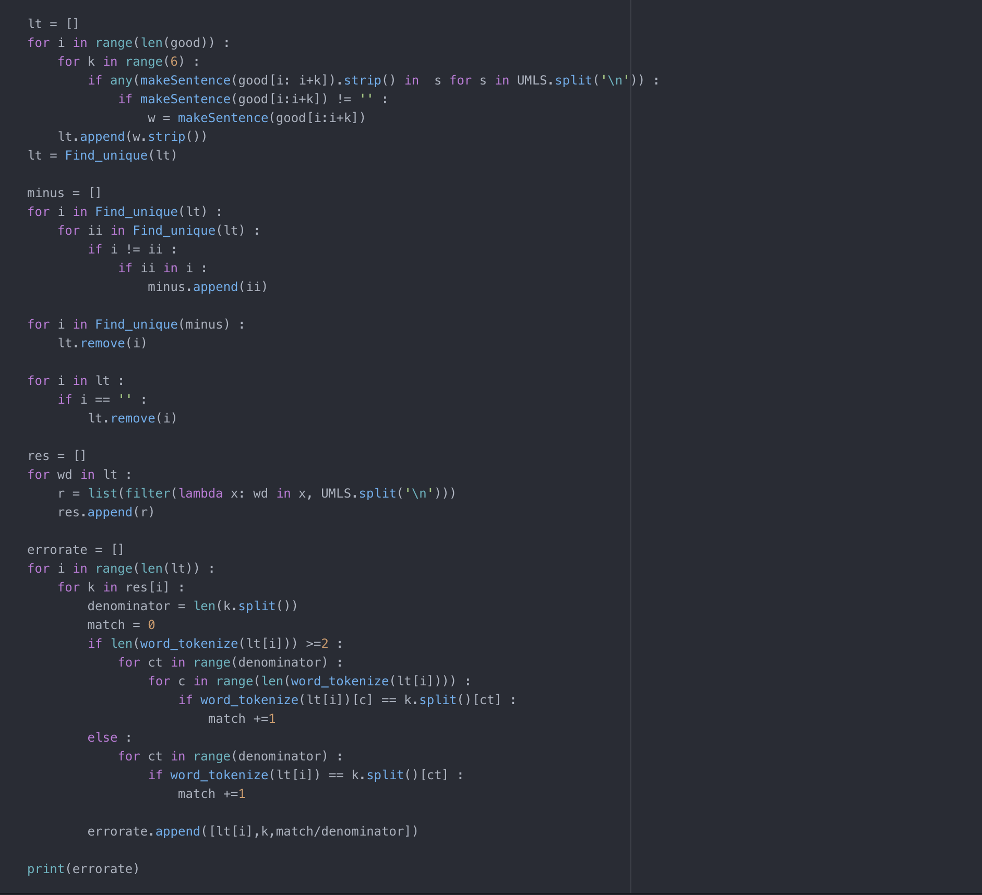
Procedures
Workflow
5. Setting UMLS to test existing values

Slide 18
Step 5 +
Unified Medical Language System (UMLS)
UMLS is a repository of biomedical vocabularies developed by US National Library of Medicine.
Integrates over 2 million names for 900,000 concepts from more than 60 families of biomedical vocabularies, as well as 12 million relation among these concepts.
Notes:
UMLS is the preferred reference to extract the core terms.

Slide 19
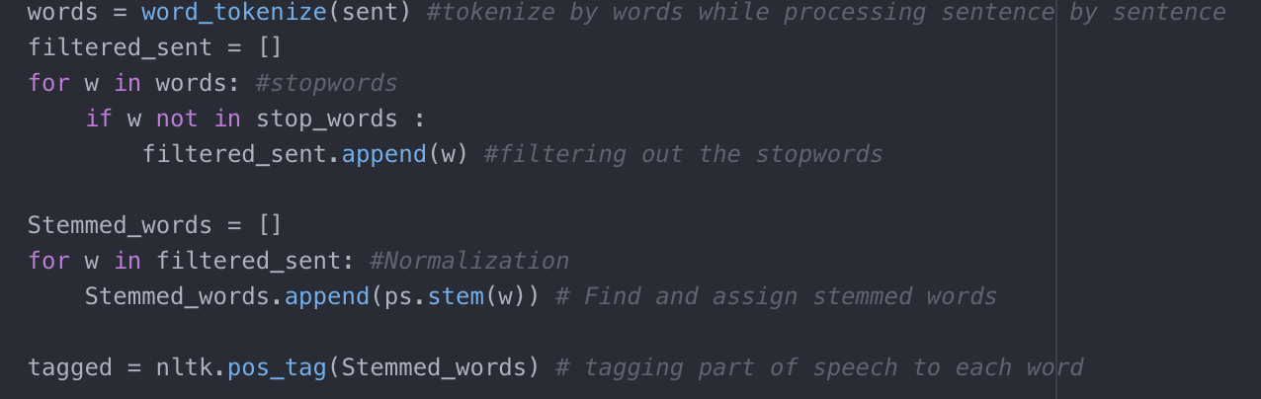
Procedures
Workflow
6. Tokenization by words, filtering against stop words, and lemmatization

Slide 20
Procedures
Workflow
7. Part-of-Speech Tagging
Clinical Information : 64 year old female with a linear non mass enhancement spanning 2.3 cm is present in the retroareolar right breast.
[('clinic', 'JJ'), ('inform', 'NN'), (':', ':'), ('64', 'CD'), ('year', 'NN'), ('old', 'JJ'), ('femal', 'JJ'), ('linear', 'JJ'), ('non', 'JJ'), ('mass', 'NN'), ('enhanc', 'NN'), ('span', 'VBD'), ('2.3', 'CD'), ('cm', 'NN'), ('present', 'JJ'), ('retroareolar', 'JJ'), ('right', 'NN'), ('breast', 'NN'), ('.', '.')]

Slide 21
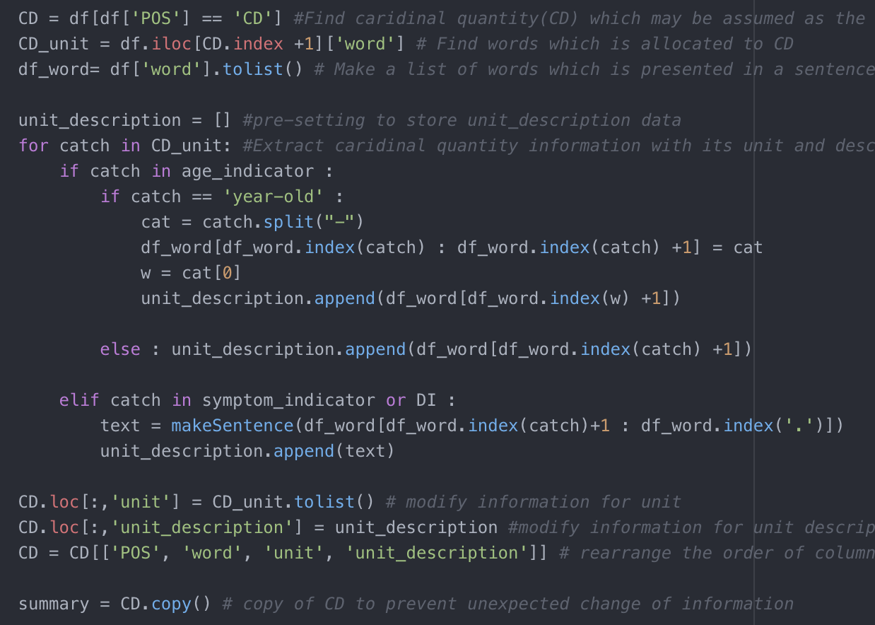
Procedures
Workflow
8. Searching for cardinal quantity values
- Because the numbers in text typically mean something.

Slide 22
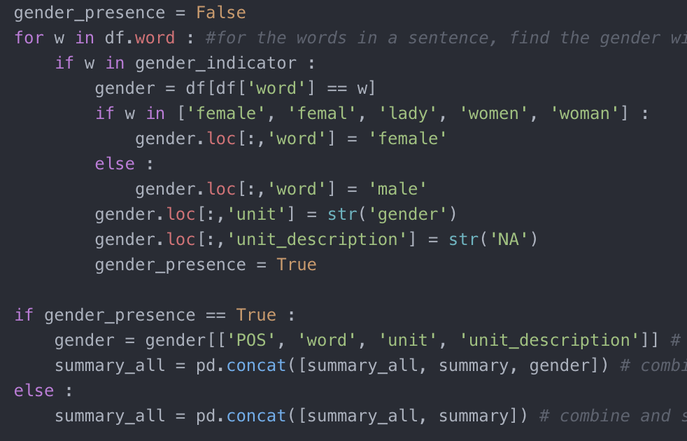
Procedures
Workflow
9. Searching for gender information

Slide 23
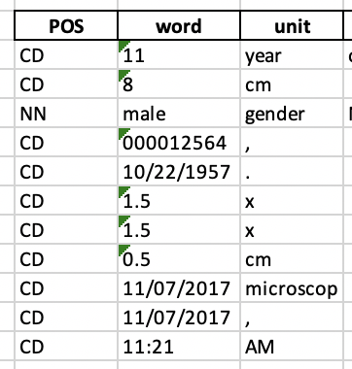
Half-way Result
Based on the Part-of-Speech,
the cardinal quantity and gender information
in the first sample are extracted.

Slide 24
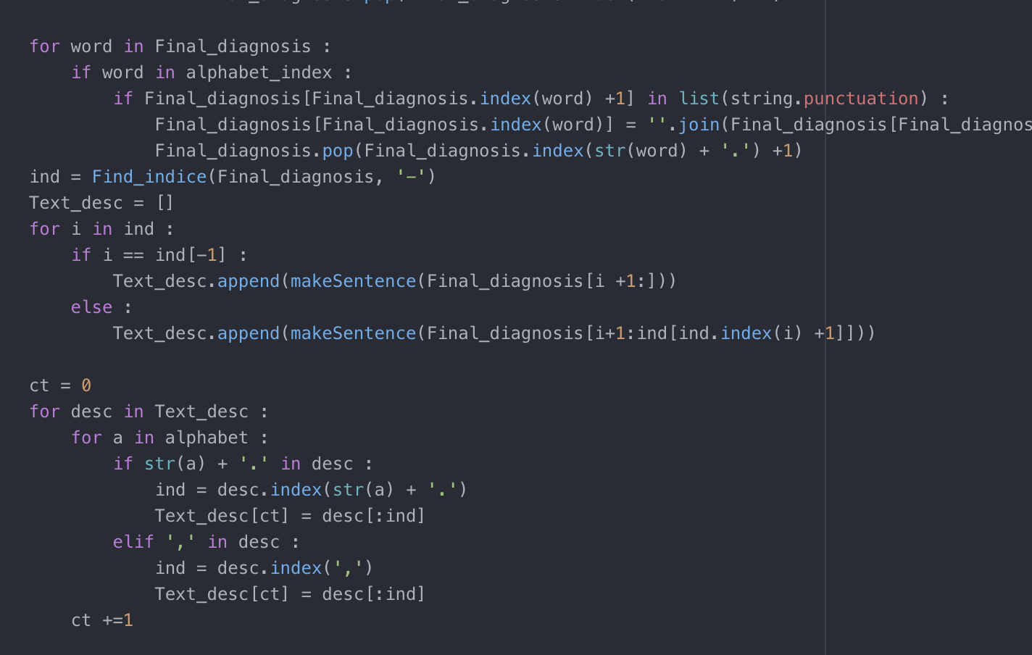
Procedures
Workflow
10. Extracting strings for each alphabetical indices in Final diagnosis

Slide 25
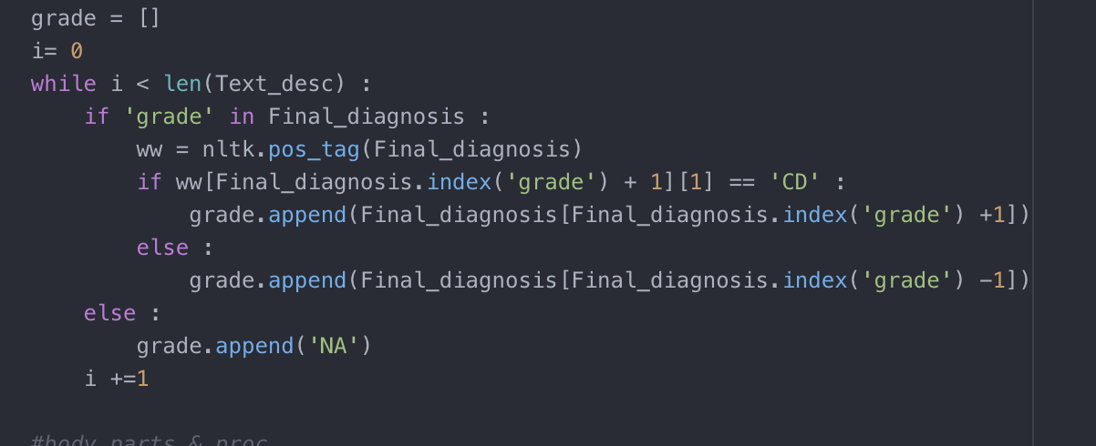
Procedures
Workflow
11. Extracting diagnosis grade information from the extracted strings

Slide 26
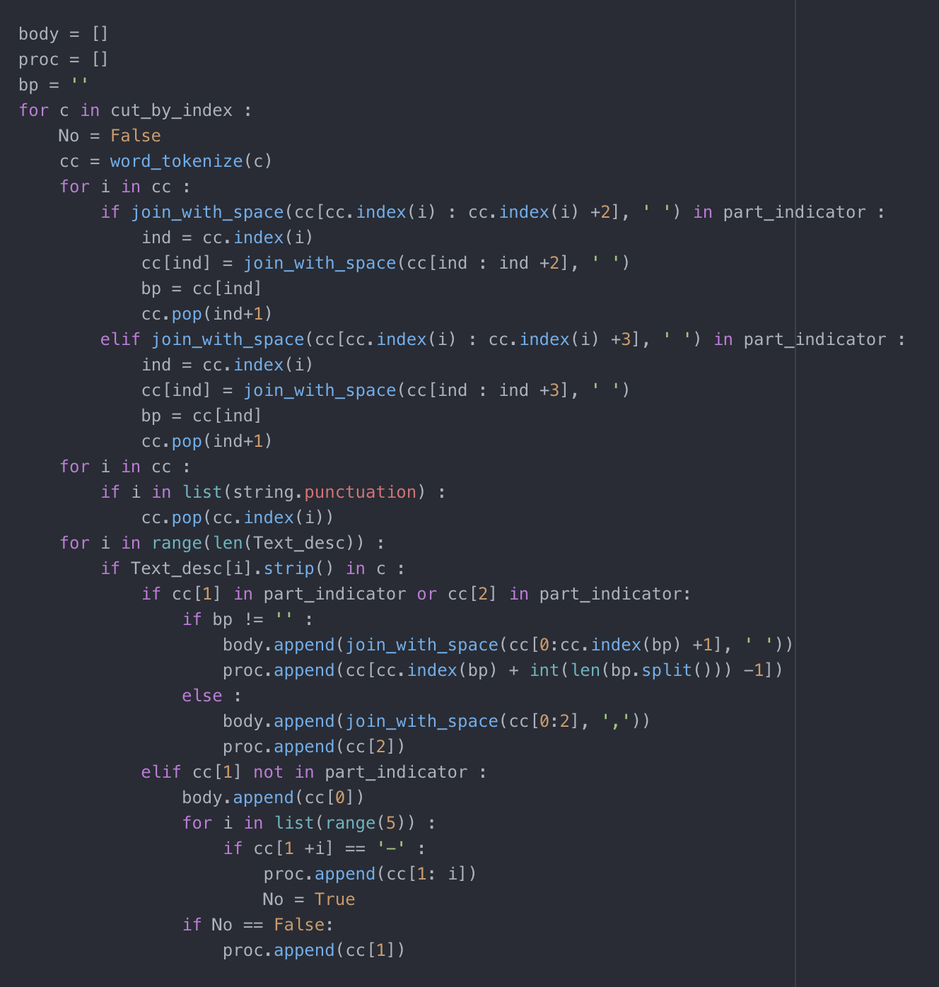
Procedures
Workflow
12. Extracting body part, clinical procedure
information from the extracted strings

Slide 27
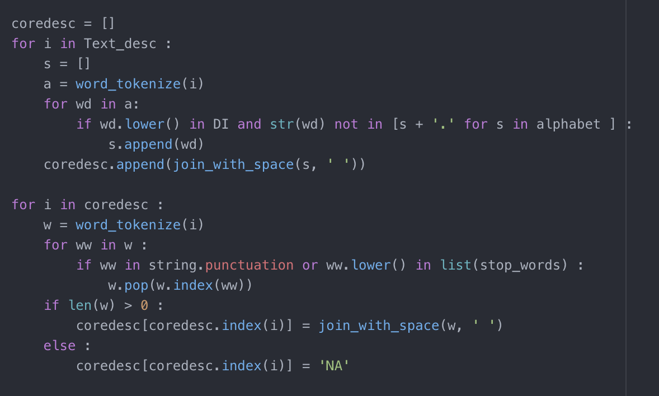
Procedures
Workflow
13. Extracting patient’s diagnoses
information and normalizing the
information to extract only core terms.

Slide 28
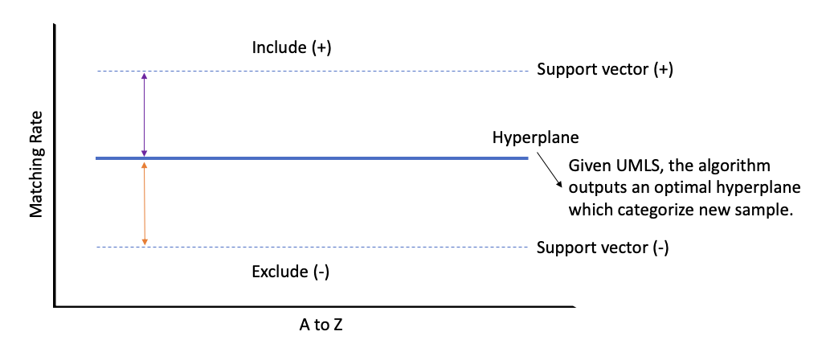
Discussion 1
Machine Learning approaches
Support Vector Machine algorithm
Every single word is tested for the matching rate against the terms in UMLS.
The locations of points are determined based on the words’ alphabetical orders and the matching rates.
Notes:
Support vector machine (SVM) is one of machine learning algorithms that analyzes data used for classification. In the figure, the x-axis refers to A to Z in alphabetical order and y-axis refers to the matching rate in range of 0 to 1. Hyperplane is drawn as an optimal output of given UMLS processed in algorithm to categorize new samples. The support vectors are generated at the closest points from hyperplane on each plus and minus sides which refer to word include and not include in final output.
The general process to calculate the matching rate is that when a sample word comes into the protocol, it is normalized and lemmatized, then compared to the word in hyperplane which is referred from UMLS lexicon. when a stemmed word has shorter letter length, the algorithm automatically generates random alphabets to fit the size. When counting the identical letters between the strings, it calculates the matching rate which is 87.5% in the example.
Ideally, the distance from hyperplane to the plus support vectors are minimized and the distance from hyperplane to the minus support vector is maximized to clarify the certain classification between includers and excluders.

Slide 29
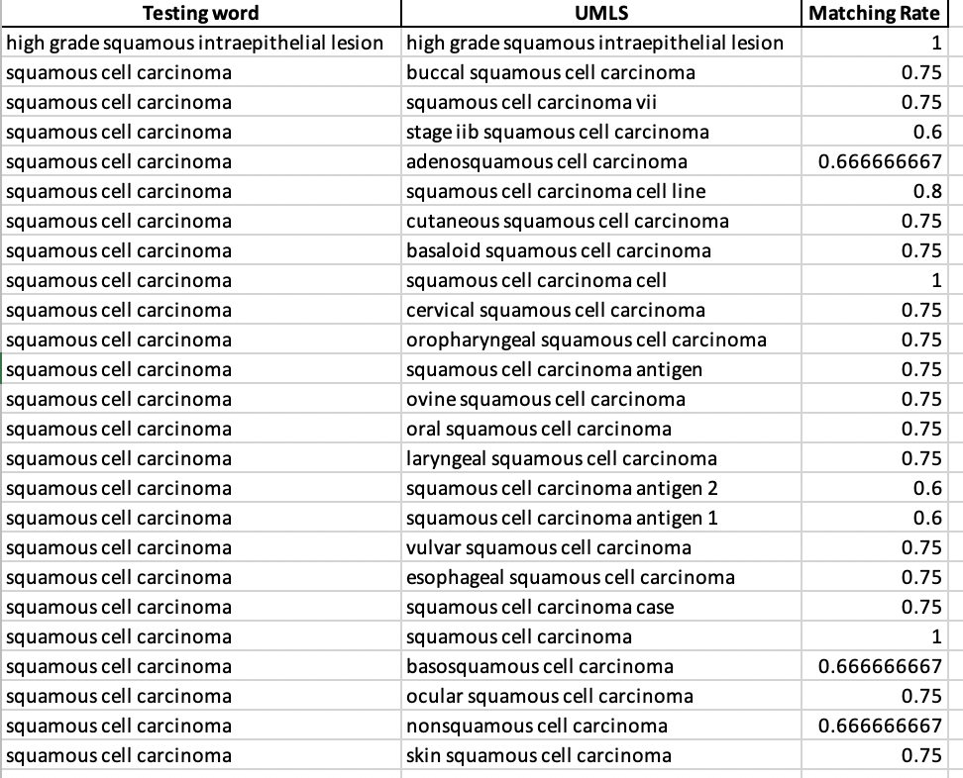
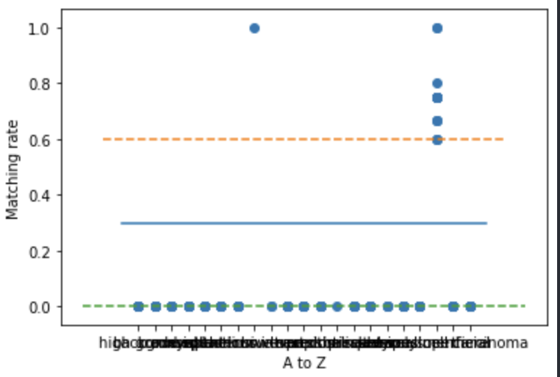
'… FINAL DIAGNOSIS : A. Cervix, biopsy: - At least high grade squamous intraepithelial lesion (CIN III) in a background of extensive necrosis, see comment. Comment : The specimen is predominately necrotic; however, there are small superficial fragments of severely dysplastic epithelium present. These findings are consistent with squamous cell carcinoma (unsampled) ...'
Words having matching rates greater or equal to 0.6
['.' 'background' 'comment' 'consistent' 'dysplastic' 'epithelium’ 'extensive' 'high grade squamous intraepithelial lesion' 'however’ 'least' 'necrosis' 'necrotic' 'predominately' 'present' 'see' 'severely'
'small' 'specimen' 'squamous cell carcinoma' 'superficial' 'there']
Notes:
In the practice, for example, I tested a sample of final diagnosis from an unidentified pathology report. I calculate the matching rates in algorithm and visualize it in Python. The blue line represents the UMLS lexicon-based hyperplane, the orange dashed line represents the plus support vector and lastly, the green dashed line represents the minus support vector. Counting the words whose points are above the plus support vector and extracting them, they are expected to represent the Final diagnosis of a certain body part and procedure.

Slide 30
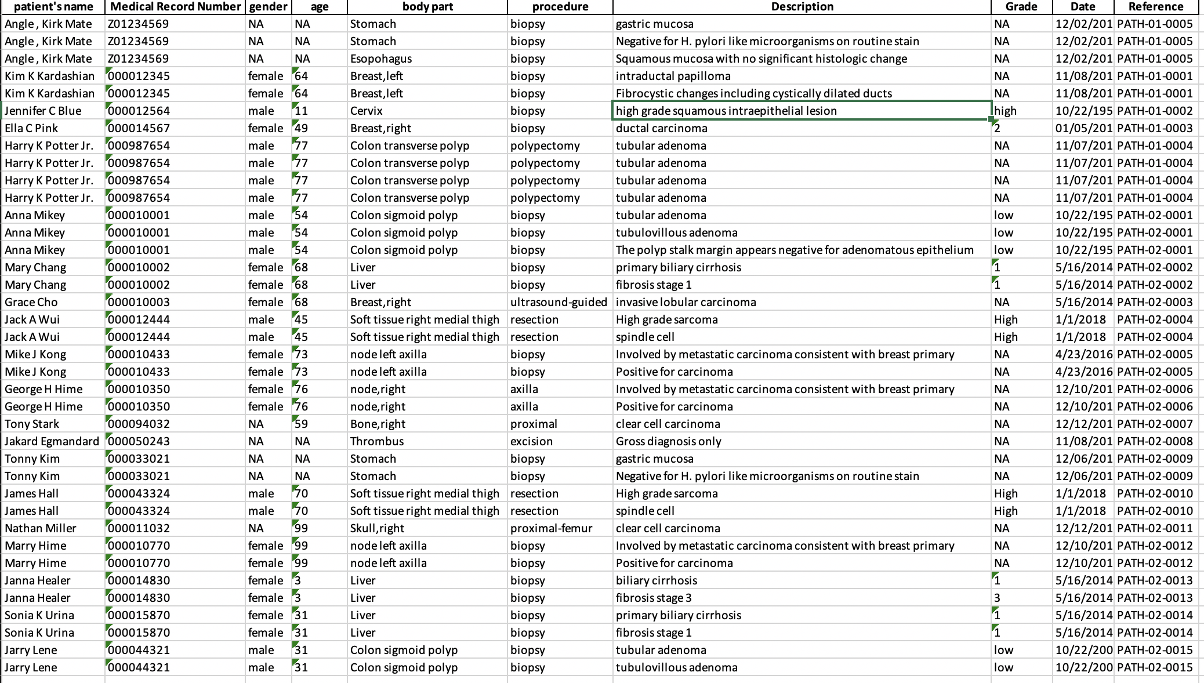
'… FINAL DIAGNOSIS : A. Cervix, biopsy: - At least high grade squamous intraepithelial lesion (CIN III) in a background of extensive necrosis, see comment. Comment : The specimen is predominately necrotic; however, there are small superficial fragments of severely dysplastic epithelium present. These findings are consistent with squamous cell carcinoma (unsampled) ...'
Since I assume that the comment section throughout all samples does not have core information, I excluded.
Notes:
Therefore, in the final result, it keeps the only words processed in the previous slide.

Slide 31
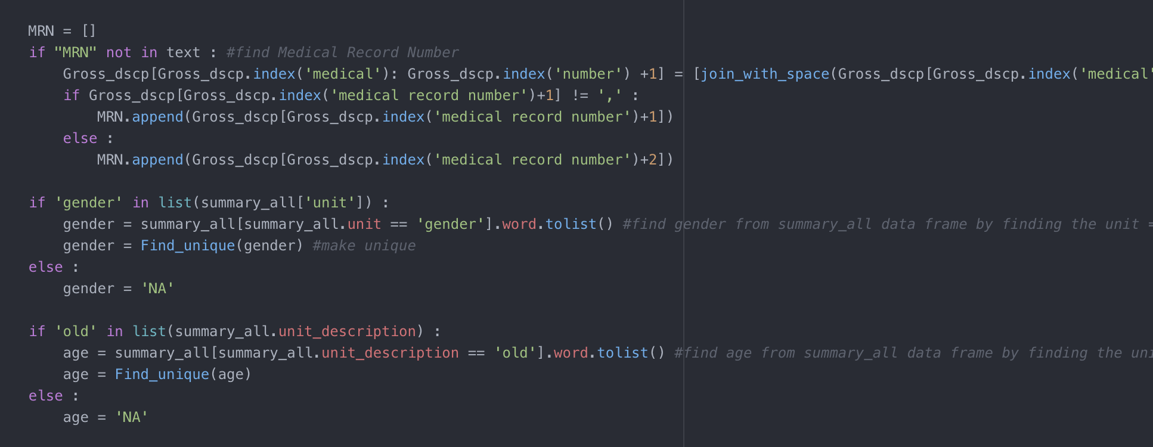
Procedures
Workflow
14. Extracting Note ID
15. Extracting Medical Record Number, gender, and age information from the table on Half-way result.

Slide 32
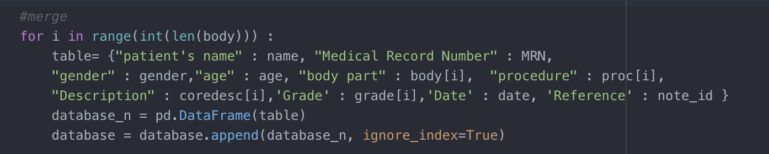
Procedures
Workflow
16. Merging and Exporting the generated information

Slide 33
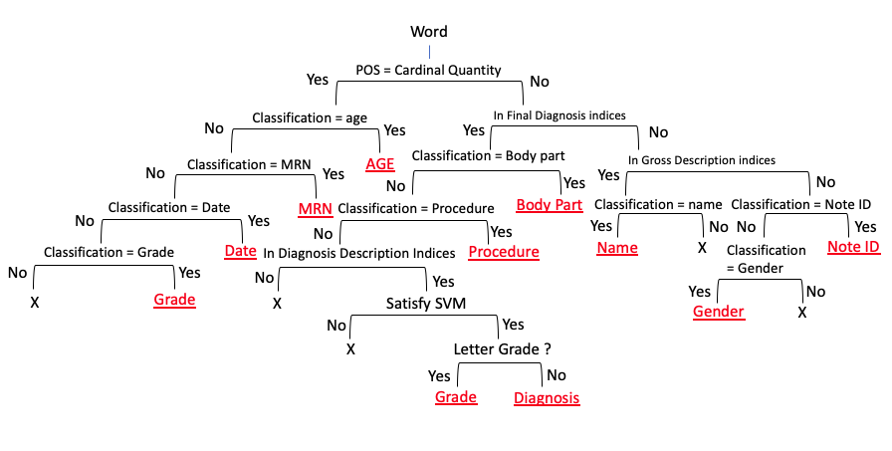
Discussion 2
Machine Learning approaches
Decision Tree algorithm

Slide 34
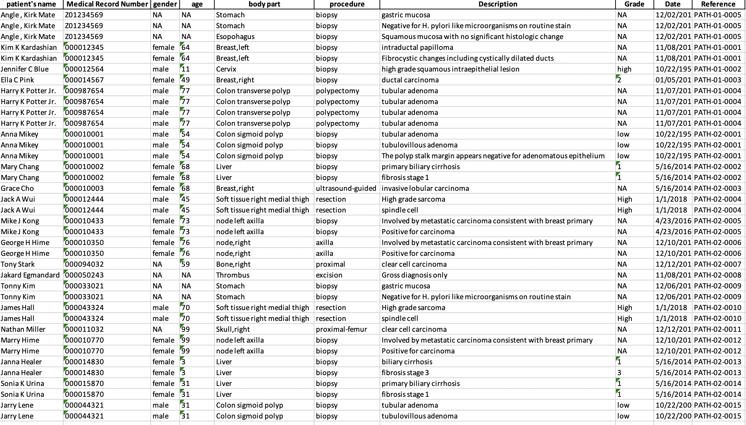
Final Result
Notes:
So, here is the outcome of processing 20 deidentified pathology report in the protocol.
The information extracted are patient’s name, Medical record number, age, body part, procedure, diagnosis description, grade of diagnosis, procedure date, and report note ID.

Slide 35
Challenge
Because the contents of the same type of reports are differently organized depending on patients’ diagnoses or the provider that entered the text,
it still challenges to extract
accurate and concise terms due to the high variances of
free-text.
Notes:
After testing for 20 different Pathology reports within Python, the information are successfully extracted.
However, because the diagnosis sample dictionary which mainly work to extract diagnosis information is trained based on the new diagnosis appeared in samples, it still challenges to extract accurate and concise terms.

Slide 36
Conclusion

Slide 37
References
Kavishwar B Wagholikar, Kathy L MacLaughlin, Michael R Henry, Robert A Greenes, Ronald A Hankey, Hongfang Liu, Rajeev Chaudhry, Clinical decision support with automated text processing for cervical cancer screening, Journal of the American Medical Informatics Association, Volume 19, Issue 5, September 2012, Pages 833–839, https://doi.org/10.1136/amiajnl- 2012-000820
Wang, Y., Wang, L., Rastegar-Mojarad, M., Moon, S., Shen, F., Afzal, N., … Liu, H. (2018). Clinical information extraction applications: A literature review. Journal of biomedical informatics, 77, 34–49. doi:10.1016/j.jbi.2017.11.011
Wall, M. (2014, March 04). Big Data: Are you ready for blast-off? Retrieved June 18, 2019, from https://www.bbc.com/news/business-26383058
KDnuggets. (n.d.). Retrieved June 21, 2019, from https://www.kdnuggets.com/2017/02/natural-language-processing-key-terms-explained.html
Ageitgey. (2019, January 02). Natural Language Processing is Fun! - Adam Geitgey. Retrieved June 21, 2019, from https://medium.com/@ageitgey/natural-language-processing-is-fun-9a0bff37854e
Kreimeyer, K., Foster, M., Pandey, A., Arya, N., Halford, G., Jones, S. F., . . . Botsis, T. (17 july 2017). Natural Language Processing Systems for Capturing and Standardizing Unstructured Clinical Information. Journal of Biomedical Informatics,1-16. doi:10.1016
Assale, M., Dui, L. G., Cina, A., Seveso, A., & Cabitza, F. (17 april 2019). The Revival of the Notes Field: Leveraging the Unstructured Content in Electronic Health Records. Frontiers in Medicine,1-23. doi:10.3389

